Slide 1
Summer School
Advanced Structural Dynamics
June 16th-19th 2025, Copenhagen (Denmark)
Fast-slow motion analysis
for friction-related problems
Lecture 1
Lecturer: Alessandro Cabboi
Assistant Professor and Acting Section Head
Section of Mechanics and Physics of Structures
Department of Engineering Structures
Faculty of Civil Enginering and Geosciences
Email: A.Cabboi@tudelft.nl

Slide 2
Outline of the lectures
Lecture 1 – 9:00-10:00
- Personal background
- Case studies of fast-slow motion analysis for friction-related problems
- Simplified and intuitive example of fast-slow motion analysis for sliding friction
Lecture 2 – 13:10-14:00
- Mass-spring system influenced by friction for a general frequency of excitation
- Worked-out example of fast-slow motion analysis for a pile driving system
Lecture 3 – 14:00-15:00
- Follow-up: worked-out example of fast-slow motion analysis for a pile driving system
- Example of results of the friction reduction of SDOF moving on an elastic rod
- Discussion on hidden (fast) motion effect on stability and dynamic friction laws

Slide 3


Personal background
PhD in Structural Engineering (2010-2014): Vibration-based damage detection on Civil Infrastructures
Several Post-doctoral positions (2014-2020): Variety of projects on nonlinear dynamics between mechanical and civil engineering.
Assistant Professor at TU Delft (Civil Engineering), since 2020.

Slide 4

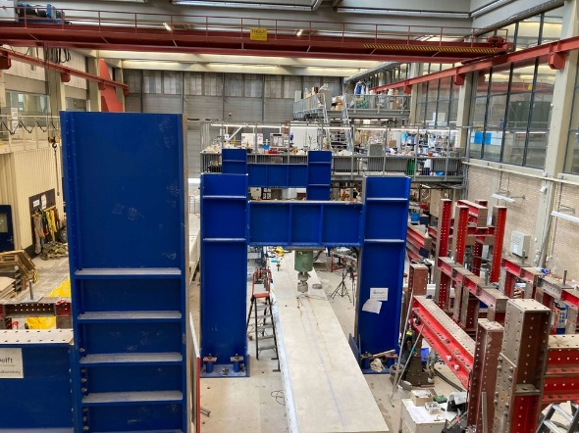
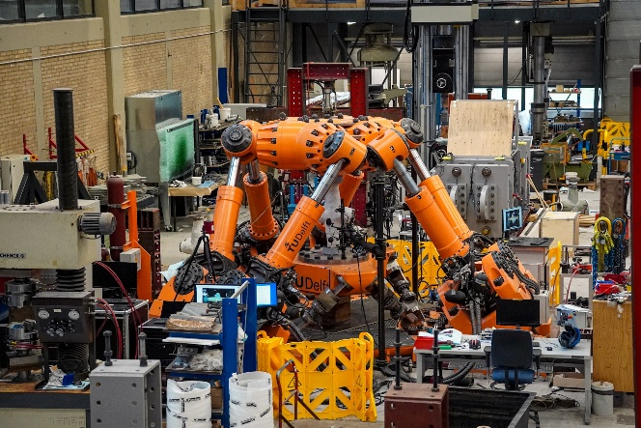
Department of Engineering Structures (TU Delft)
Part of the Faculty of Civil Engineering and Geosciences (it consists of 7 Departments)
Department of Engineering Structures: it consists of 8 sections
Steel and Composites Structures
Biobased Materials and Structures
Dynamics of Solids and Structures
Railway Engineering
Pavement Engineering
Resources and Recycling
Concrete Structures
Mechanics and Physics of Structures

Slide 5





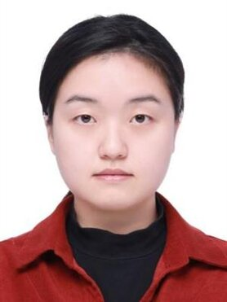

What do we do in Mechanics and Physics of Structures ?
M. Steenbergen
A. Cabboi
Group of PhD candidates and Post-docs
E. Sulollari
Y. Zheng
S. Zhou
Main areas of research
Vibration propagation
Dynamic characterization of systems
Contact dynamics and tribology
Nonlinear vibration and damping
S. Song
Y. Zheng

Slide 6
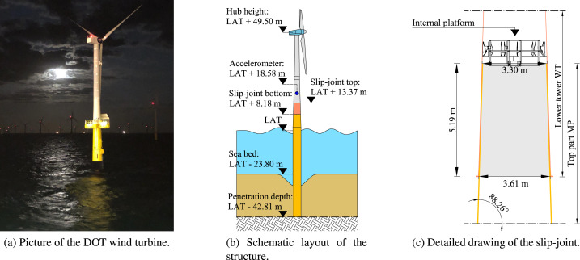
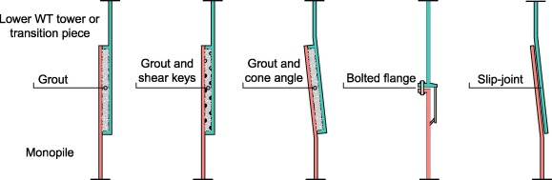
How did I end up working on slow-fast motions?
One of my post-doctoral projects in 2018 was about the installation and decommissioning of a slip joint for wind turbine connections.
- The concept of a slip joint is still not used as a standard design concept. The two tasks I had to work on at TUD were: can we exploit an induced fast vibration to (a) create a sound contact during installation and (b) disconnect the slip joint in case of decommissioning of the wind turbine?
The two images from this slide and from the next slide are taken from:
Alessandro Cabboi, Thijs Kamphuis, Evert van Veldhuizen, Maxim Segeren, Hayo Hendrikse, Vibration-assisted decommissioning of a slip joint: Application to an offshore wind turbine, Marine Structures, Volume 76, 2021.
Alessandro Cabboi, Maxim Segeren, Hayo Hendrikse, Andrei Metrikine, Vibration-assisted installation and decommissioning of a slip-joint, Engineering Structures, Volume 209, 2020.

Slide 7
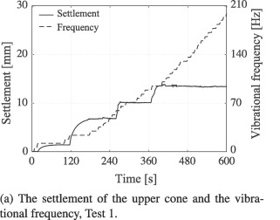
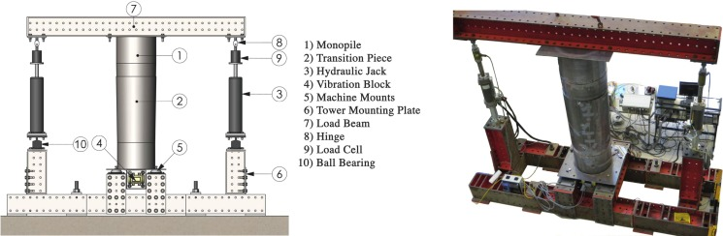
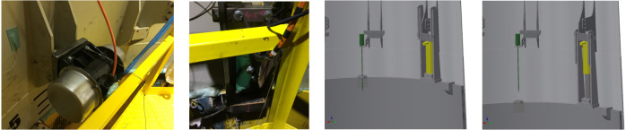
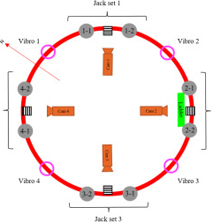
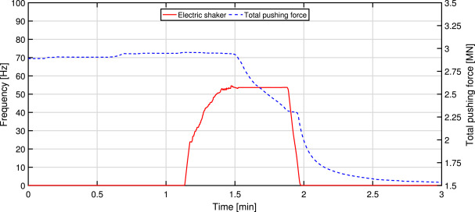
Some results from the slip joint project
Lab-scale tests
Offshore tests

Slide 8
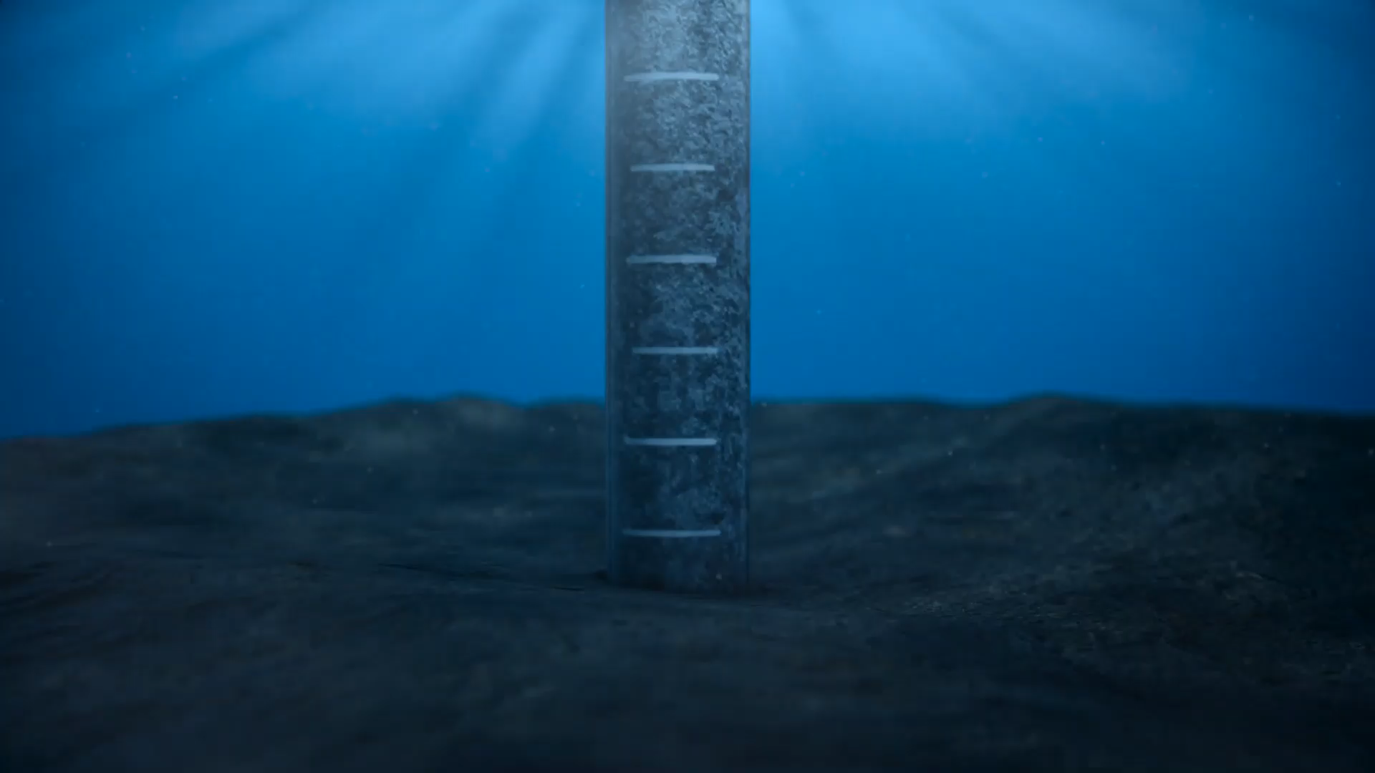
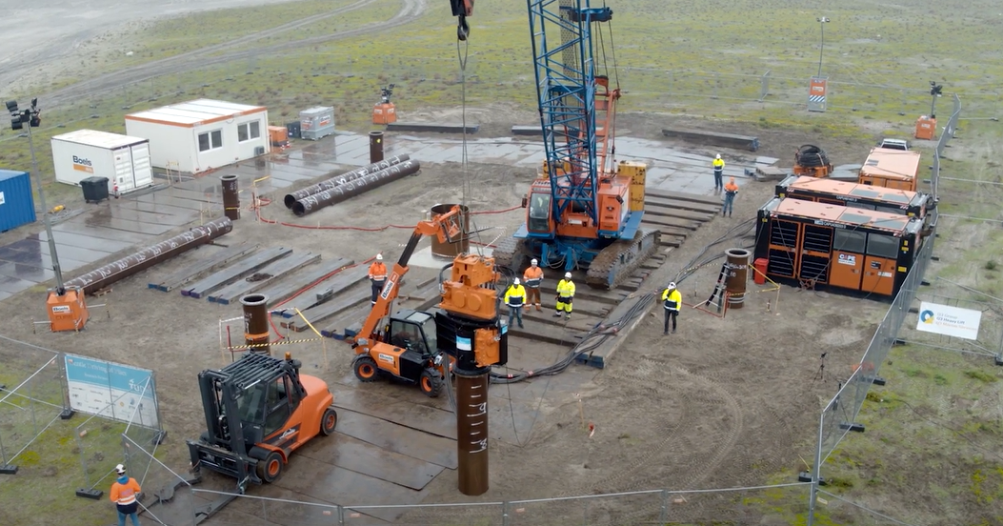
Are there other applications in which we can alter the friction behaviour through vibration? Part 1
Pile driving for monopiles
An alternative installation method was proposed by TU Delft: the Gentle Driving of Piles (GDP).
Idea consists to combine:
a) low-frequency/axial &
b) high-frequency/torsional loading
GDP method is envisaged to:
improve installation performance
reduce noise emissions
This slide is a courtesy from: Dr. Athanasios Tsetas. More details on this work can be found in his recent papers, specifically: Tsetas A., Tsouvalas A., Metrikine, The mechanics of the Gentle Driving of Piles (2023) International Journal of Solids and Structures.

Slide 9
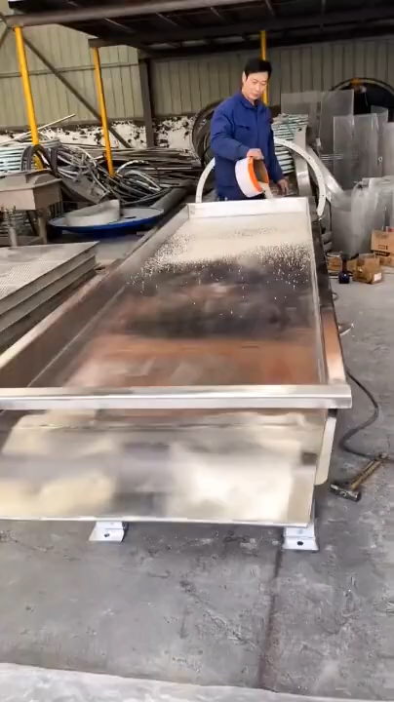
Are there other applications in which we can alter the friction behaviour through vibration? Part 2
Vibrational displacement or vibration separation of particles
In recycling processes, vibrating conveyors are more often used to even distribute materials that need to be separated and recycled
Applications span from chemical industry, food industry and to mining
https://www.youtube.com/shorts/bCSknafmmOU

Slide 10
What are the current challenges concerning the interaction of friction and vibration ?
Commonly, you see studies focused on this type of question:
How does friction influence the vibration response?
However, what if we want to exploit vibration to alter/control the friction process?
Open challenges (many actually, here are just some of them):
In general, we never know the exact friction/contact law governing the material pair.
For now, one mechanism is known the can govern the vibration-induced friction modulation: redirection of the friction force throughout one cycle of vibration. However, are there other mechanisms at play? If so, are they relevant?
Which is the most optimal/efficient modelling/predictive strategy to control this process?

Slide 11
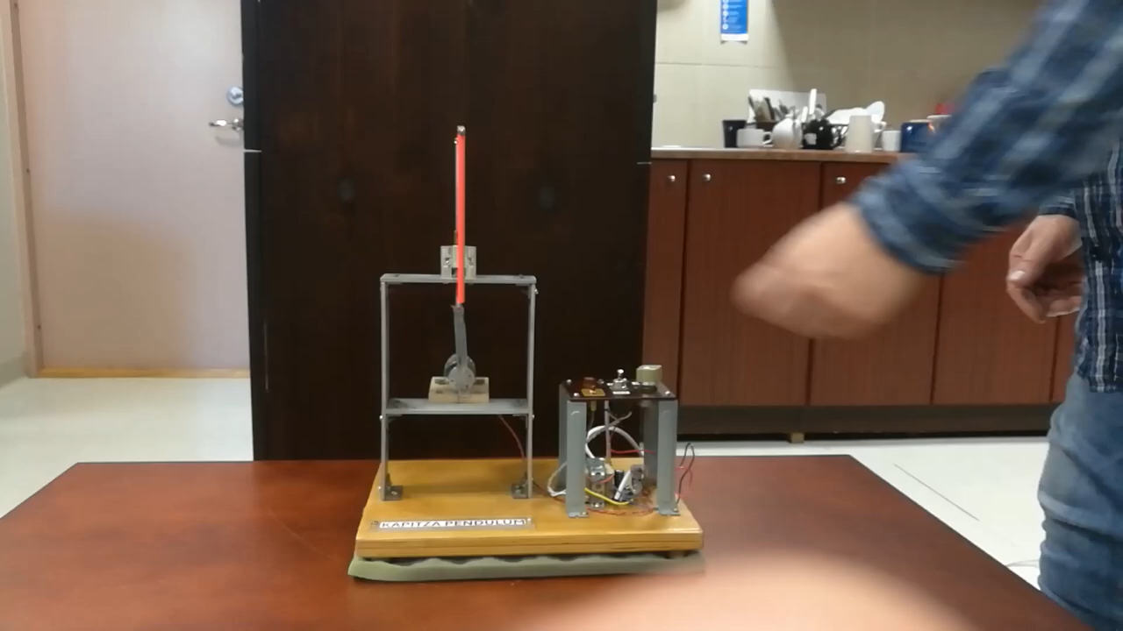
General overview on fast-slow motion induced effects
Good references:
Vibrations and stability: Advanced theory, Analysis, and Tools , J. J. Thomsen (3rd edition)
Vibrational mechanics: nonlinear dynamic effects, general approach, applications, I. I. Blekhman
General effects
Stiffening
Biasing
Smoothening
Parametrically-induced change of stiffness
(e.g. Kapitsa’s pendulum)
Change of static equilibrium position
(e.g. Kapitsa’s pendulum, Brumberg’s pipe)
Smoothening discontinuities (e.g.dry friction into “viscous friction”)
https://www.youtube.com/watch?v=RJid-eCtLdQ

Slide 12
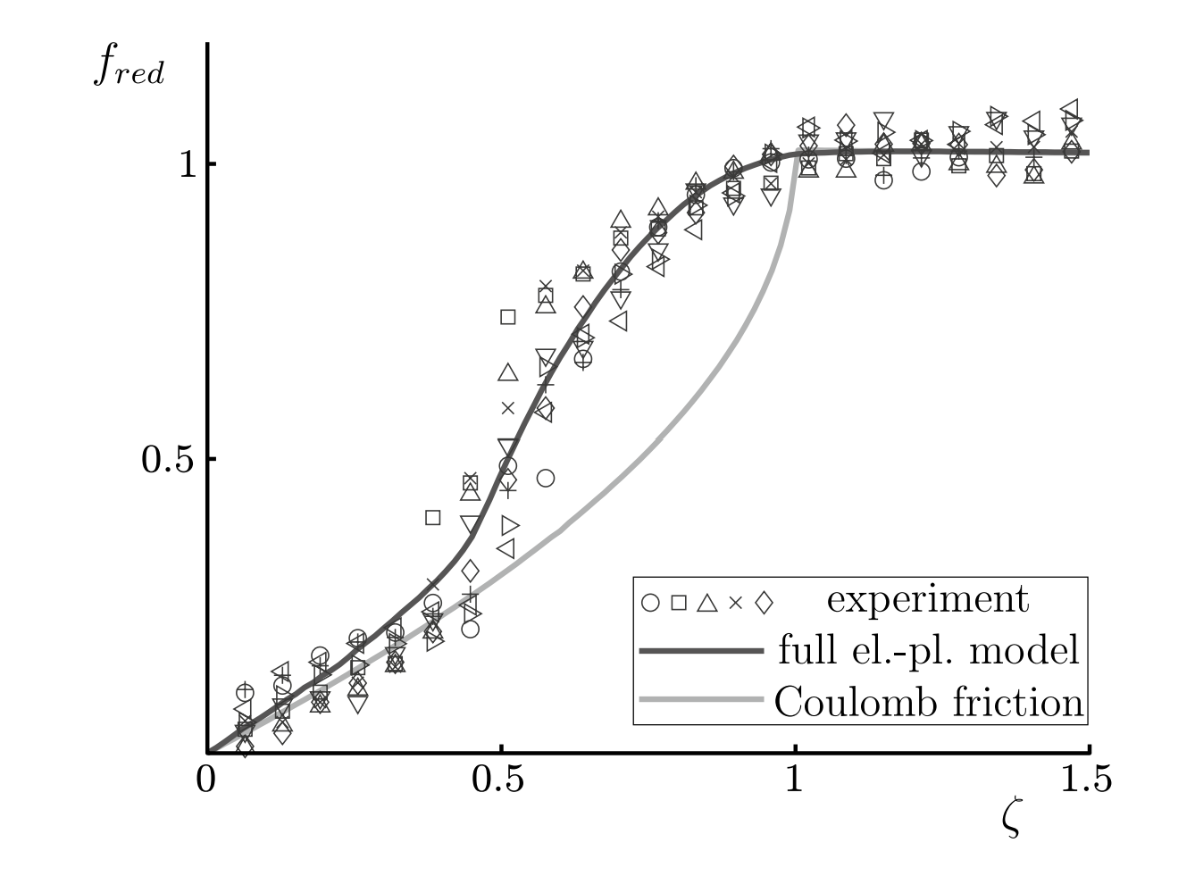
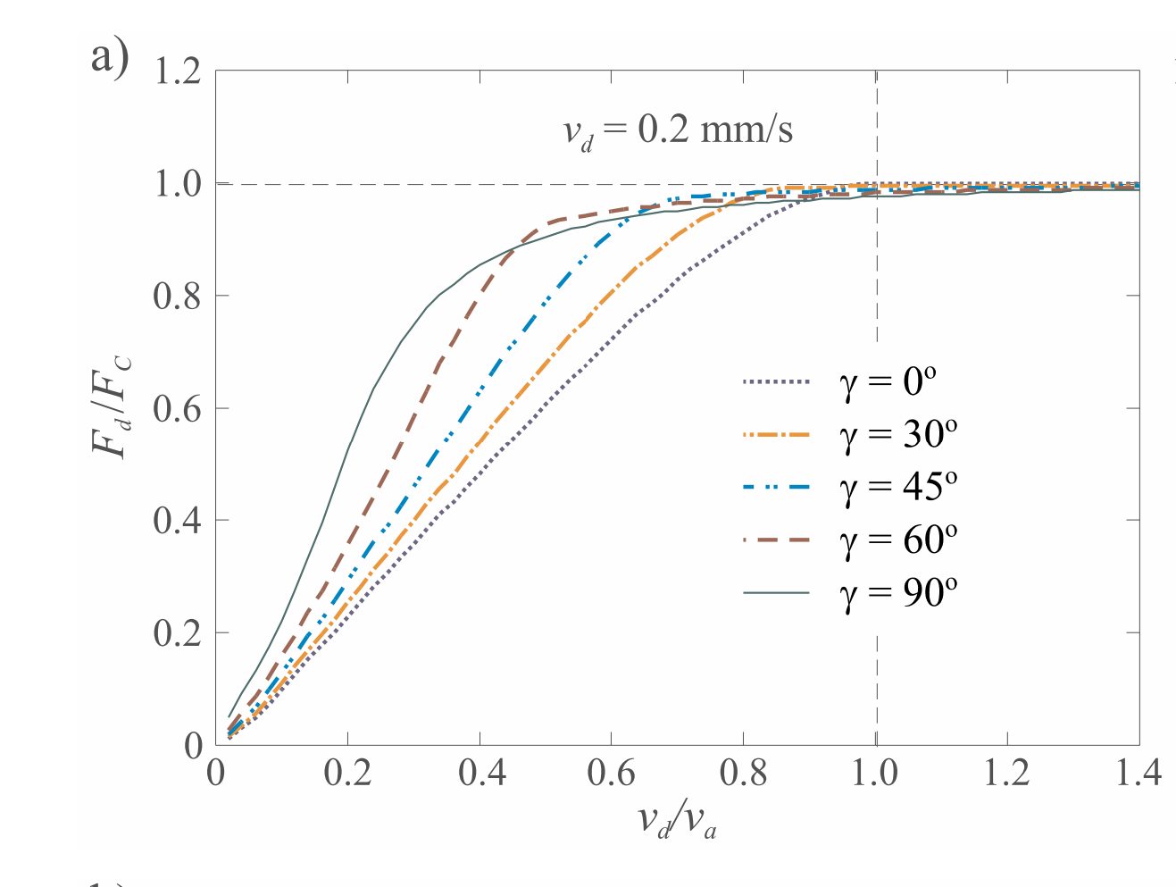
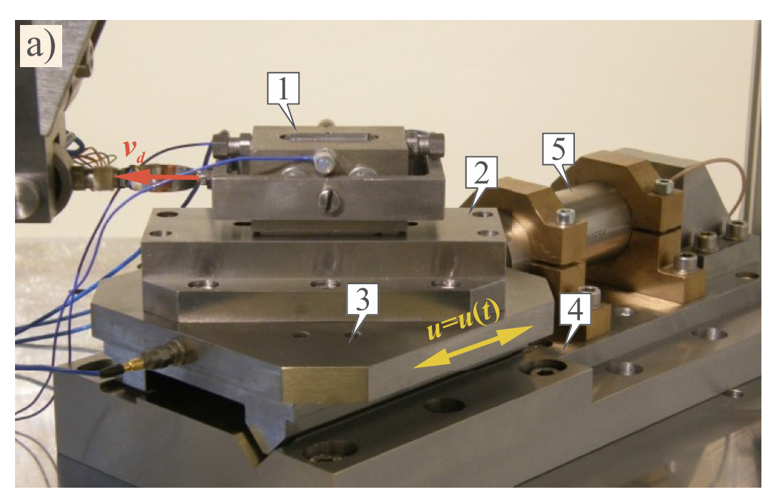
Intuitive example of smoothening:
transforming dry friction into “viscous friction”
Experiments date back to the late ’60s, however, compared to other areas, it is still a niche topic: not so many experiments available (often very ideal ones) to fully understand the mechanisms at place.
Kapelke, S. et al (2018)
Images taken from: Gutowski, P., Leus, M. Computational model of friction force reduction at arbitrary direction of tangential vibrations and its experimental verification, Tribology International 143 (2020) 106065.
Image taken from: Kapelke, S. et al, On the effect of longitudinal vibrations on dry friction, Tribology Letters (2018) 66:79, https://doi.org/10.1007/s11249-018-1031-0

Slide 13
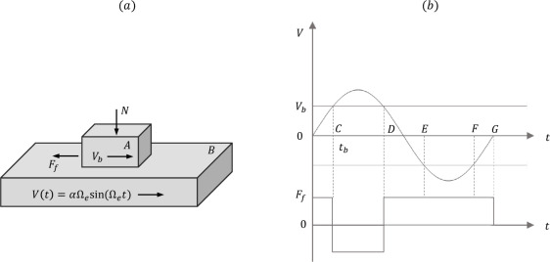
Intuitive example of smoothening:
transforming dry friction into “viscous friction”
Case of longitudinal (tangential) excitation
The reasoning here is to look after the averaged friction over one cycle (period T of the fast applied excitation)
What’s is the area equal to?
t_{b} is the time at which the velocity of the fast excitation equals the pulling velocity V_{b}
Images taken from: Sulollari, E., Van Dalen, K., Cabboi, A. Vibration-induced friction modulation for a general frequency of excitation, Journal of Sound and Vibration, 573,118200, (2024)
The area under CD cancels with the area under EF. What is left is:

Slide 14
Intuitive example of smoothening:
transforming dry friction into “viscous friction”
Case of transversal excitation
The component of the friction force in direction of the macroscopic movement (x-direction) is averaged over one period of vibration:
Use of elliptical integral identity:

Slide 15
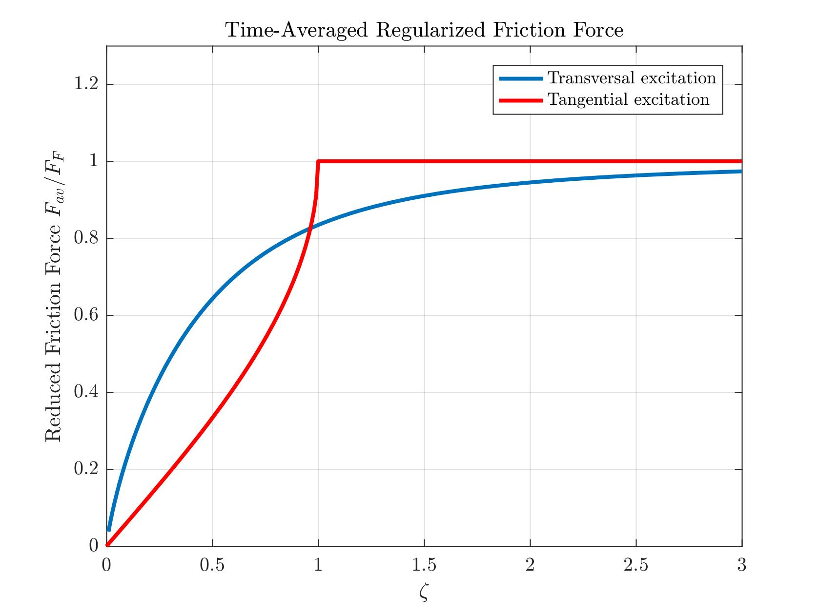
Intuitive example of smoothening:
transforming dry friction into “viscous friction”
Case of tangential excitation
Case of transversal excitation

Slide 16
Since we use an additional vibration, are we consuming more energy? In general, is there a benefit ?
The work done by a friction force is equal to (it corresponds to the dissipated energy):
In case of applied vibration, the argument becomes:
Let’s adimensionalize this through
This integral is a bit tedious because of the sign term and change of sign depending on ζ, and it has to be solved for two conditions:
if
In case without vibration:
if

Slide 17
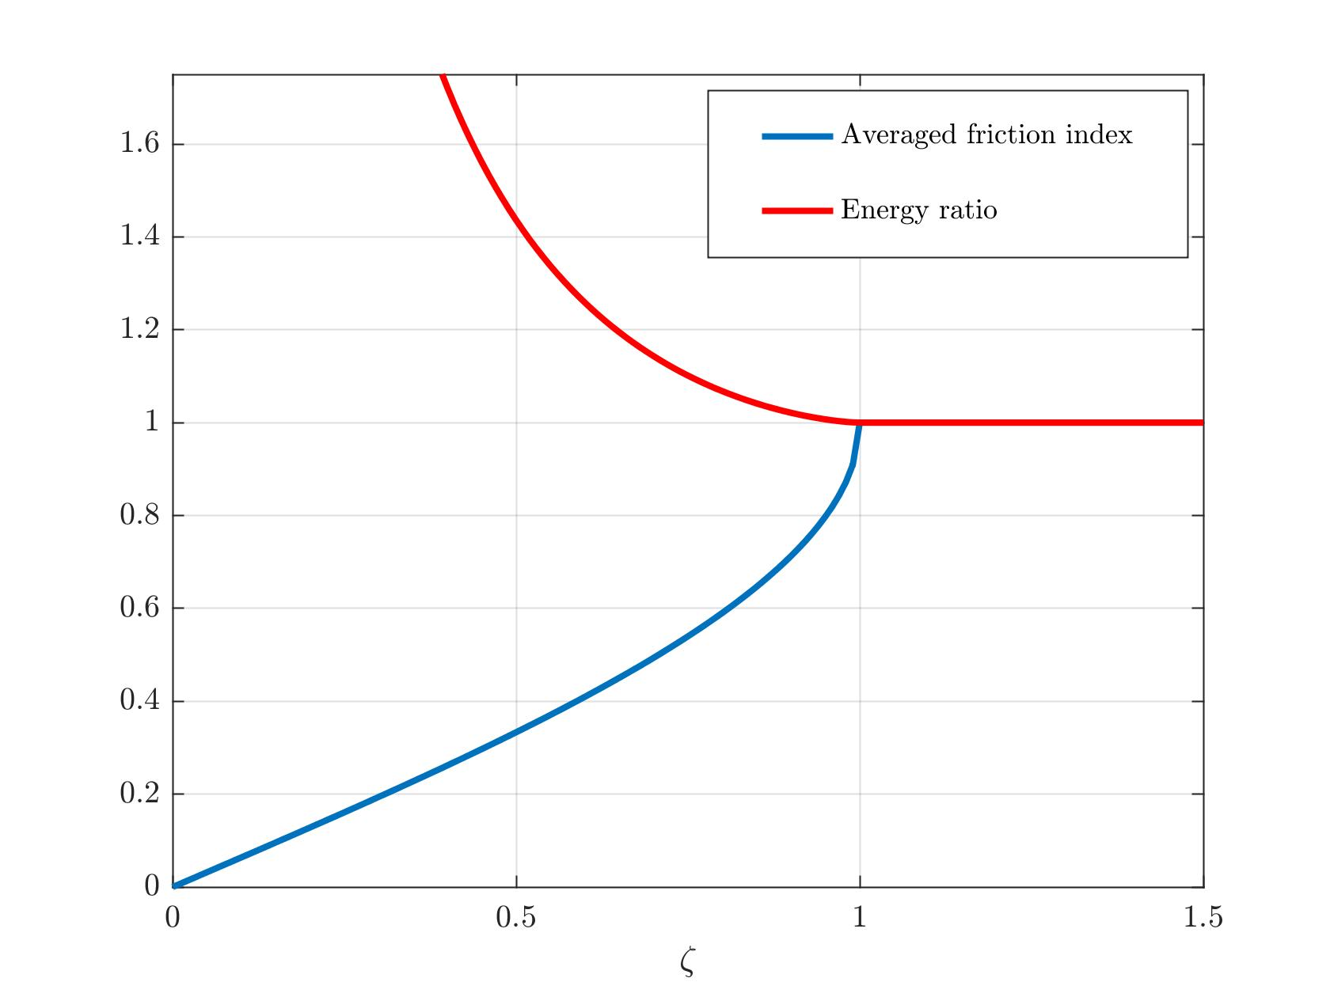
Since we use an additional vibration, are we consuming more energy? In general, is there a benefit ?

Slide 18
Where do we go from this point on?
Possible benefits from this transformation of dry (discontinuous) friction to a regularized viscous friction:
Reduction or control of the friction force
It can mitigate/eliminate stick-slip, chaos and friction-induced instability
Note: if such external vibration is not accounted for, and some friction force measurements are taken, there is a risk to misinterpret the measured friction force (more on this in lecture 3)
Next steps: a high frequency was mentioned, but what is meant by high? Can we generalize the outcome to a general class of dynamic systems?

Slide 19
Introduction to the Method of Direct Separation of Motion
General class of systems
We assume a solution of the following type
Slow motion
Fast motion
The method of the direct separation of motions was originated by Kapitsa in the ’60s, and the general formulation of this method was given later by Blekhman.
The main idea here is to to find another system, which solution is close to the solutions of the original system.

Slide 20


